Slide 1
Negotiation
Global Procurement Perspective
From:
Presented by:
Akshay Sharma
13PGP008
Chapter 13
Chapter 20
Notes:
Chapter 13

Slide 2
Chapter Overview
What is negotiation?
Negotiation framework
Negotiation planning
Power in negotiation
Concessions
Negotiation tactics: trying to reach agreement
Win-Win negotiation
International negotiation
Comprehensive global negotiation skills and enhanced cultural understanding
The impact of the Internet on negotiations

Slide 3
What Is Negotiation?
Direct:
A process of formal communication, either face-to-face or via electronic means, where two or more people come together to seek mutual agreement about an issue or issues
Involves the management of time, information, and power between individuals and organizations who are interdependent
Indirect:
Relationships between people, not just organizations
Persuasion
Negotiation skills can be honed and practiced

Slide 4
Terms Used in Negotiation
Positions
Interests
Needs
Wants
BATNA (Best Alternative To a Negotiated Agreement)

Slide 5
Positions
A negotiator’s opening offer
Represents the optimistic or target value of the issues being negotiated
The stated demand at the negotiation table

Slide 6
Needs vs. Wants
Needs – those negotiated outcomes that the negotiator must have in order to reach a successful conclusion
Wants – those negotiated outcomes that a negotiator would like to have
May often be exchanged as concessions

Slide 7
Interests
The unspoken motivation or reason that underlies any given position
Unlikely to be expressly stated or acknowledged during the negotiation
May not be directly germane to the position
May be personal in nature
Key Points on Interests
Play detective and try to discern the other party’s interests through a series of open-ended, probing questions
Always focus on the other party’s underlying interests, not his/her stated positions

Slide 8
BATNA (Best Alternative To a Negotiated Agreement)
What is BATNA:
Negotiating Without Giving In.
A party should generally not accept a worse resolution than its BATNA.
Bottom line or reservation point
Walk away if outcome is better than BATNA
Need to ensure that a negotiator’s BATNA is never revealed to the other party
All settlements must be judged in light of all other viable alternatives
Accounts considered: relationship value, time value of money and the likelihood that the other party will live up to their side of the bargain
Notes:
en.wikipedia.org/wiki/Best_alternative_to_a_negotiated_agreement

Slide 9
Triangle Talk
Step 3:
Propose Action in a Way that They Can Accept
The Negotiation Process
Step 1:
Know Exactly What You Want
Step 2:
Know Exactly What They Want

Slide 10
Know Exactly What You Want
Determine and write down specific goals and objectives
Can be referred during the negotiation
The more clearly defined, the more likely that can be achieved

Slide 11
Know Exactly What They Want
Attempt to discern the other party’s likely needs and wants
Estimate underlying interests to the other party’s stated positions
Beware of expecting the other party to think in the same way
Ask open-ended questions to confirm or counter preconceived notions

Slide 12
Propose Action They Can Accept
Frame your own needs in terms of the other party’s needs
Make it easy for the other party to say, “Yes”
Remain fair, flexible, and reasonable

Slide 13
Negotiation Framework
Identify or anticipate a purchase requirement
Determine if negotiation is required
Plan for the negotiation
Execute the agreement
Conduct the negotiation

Slide 14
Identify or Anticipate a Need
Purchase requisitions
Inventory counts
Reorder point systems
New product development
New facilities

Slide 15
Is Negotiation Required?
Is bid process inadequate?
Are many non-price issues involved?
Is contract large?
Are technical requirements complex?
Does contract involve plant and equipment?
Does contract involve a partnership?
Will supplier perform value-adding activities?
Will there be high risk or uncertainty?

Slide 16
When to Negotiate
Identification of allowable costs
Delivery schedules and lead times
Expected product and service quality levels
Performance metrics
Technological support needed
Contract volumes
Special packaging
Loss and damage liability
Payment terms and currency issues
Progress payment schedules

Slide 17
When to Negotiate
Transportation mode selection
Carrier selection
Filing freight claims
Warranties and replacements
Capacity issues
Material lead times
Penalty clauses
Performance incentives
Contract length
Contract renewal mechanism
Proprietary information

Slide 18
When to Negotiate
Intellectual property
Resources related to closer buyer-supplier relationships
Contract resolution mechanisms
Spare parts
After-sale service
Operator and maintenance training
Improvement requirements
Quality
Delivery performance
Lead time
Cost

Slide 19
Reasons for Negotiation
Total contract value or volume is large
Purchase involves complex technical requirements, perhaps even product and process requirements and specification still evolving
Purchase involves capital-intensive plant and equipment
Agreement involves a special or collaborative buyer-supplier relationship
Supplier will perform important value-adding activities

Slide 20
Plan for the Negotiation
Identify participants
Develop objectives
Analyze strengths and weaknesses
Gather information
Recognize other party’s needs
Identify facts and issues
Establish positions
Develop strategies and tactics
Brief personnel
Practice the negotiation

Slide 21
Establish Positions
Example is a buyer-seller price negotiation
Buyer
Aspiration Point
Aspiration Point
B.A.T.N.A.
Zone of Likely Agreement
B.A.T.N.A.
Seller
Zone of Likely Agreement = Zone of Possible Agreement (ZOPA)
Notes:
Zone of Possible agreement

Slide 22
Conduct the Negotiation
Perform fact finding
Recess or caucus as necessary
Work to narrow differences
Manage time pressures
Maintain informal atmosphere
Summarize progress periodically
Employ tactics
Keep relationships positive

Slide 23
Points to Focus On
Defining the issues
Defining interests
Defining objectives and openings
Assessing constituents and social context
Analyzing the other party
Planning issue presentation and defense
Defining protocols
Where to negotiate

Slide 24
Face-to-Face Negotiation Phases
Fact finding and information sharing
Recess to:
Reassess relative strengths and weaknesses
Review and revise objectives and positions
Reorganize the negotiation agenda
Narrow differences
Seek agreement and conclusion
May involve several iterations

Slide 25
Being an Effective Negotiator
Willing to compromise or revise goals
View issues independently
Establish upper and lower ranges for each major issue
Explore additional options
Build on common ground between parties
Avoid making irritating comments
Avoid argumentation by presenting too many reasons
Make fewer counterproposals

Slide 26
Execute the Agreement
Provide performance feedback
Build on the success of the negotiation
Monitor contract provisions

Slide 27
Power in Negotiation
Power is the ability to influence another person or organization
Power by itself is neither good or bad; it is the application or use of power that makes it good or bad
Sources of negotiating power

Slide 28
Sources of Negotiating Power
Informational power
Reward power
Coercive power
Legitimate power
Expert power
Referent power

Slide 29
Informational Power
Ready access to relevant and useful information
Presentation of facts, data, and persuasive arguments
Can be manipulated by withholding information or by providing false information

Slide 30
Reward Power
One party is able to offer something of perceived value to the other
Direct attempt to exert control
Individuals respond and behave accordingly when valued rewards are available

Slide 31
Coercive Power
Taking away or withholding something of value to the other party
Ability to punish – financially, physically, or mentally
Can have damaging effects on long-term relationships
Promotes escalation of conflict or retaliation

Slide 32
Legitimate Power
Special form of informational power
Often represented by verifiable credentials
Reduces the likelihood of refuting a position
Other party must value the expertise in order to be effective

Slide 33
Referent Power
Comes from attraction based on socially acceptable personal qualities and attributes
Physical
Honesty
Charisma
Friendliness
Sensitivity

Slide 34
Use of Power
Used to support one’s advantage
Need to be careful not to abuse power
Damaged relationships
Invited retaliation
Diminished value of that power
Some types of power interact synergistically with others
Example - expert and referent power

Slide 35
Concessions
Movement away from a negotiating position that has value to the other party
Give-and-take process is normal in most negotiations
Need to avoid giving away concessions without receiving something of equal or greater value in return

Slide 36
Guidelines for Making Concessions
Give yourself enough room to make concessions
Try to get the other party to start revealing its needs and objectives first
Be the first to concede on a minor issue but not the first on a major one
Make unimportant concessions and portray them as valuable
Make the other party work hard for every concession you make
Use tradeoffs to obtain something for every concession you make

Slide 37
Guidelines for Making Concessions
Generally, concede slowly and give a little with each concession
Do not reveal your deadline to the other party – ever
Occasionally, say “No” to the other party
Be careful trying to take back concessions, even tentative ones
Keep a record of concessions made to try and identify a pattern
Do not concede too often, too soon, or too much

Slide 38
Negotiation Tactics
Low ball
Honesty and openness
Questions
Caucus
Trial balloon
Price increase
High ball
Best and final offer
Silence
Planned concessions
Venue

Slide 39
Power of Influence
Reciprocation
Consistency
Social proof
Liking
Authority
Scarcity

Slide 40
Reciprocation
An obligation to give something back of equal or greater value to someone after having received something from them
Creates a powerful obligation response
Can be used effectively when giving concessions
Patterns of concession (quid pro quo)

Slide 41
Consistency
People tend to want to be perceived as being consistent in their beliefs and actions
It is difficult to back away from something already agreed to
Beware the consistency trap
Small commitments often lead to larger ones

Slide 42
Social Proof
Looking to the behavior of others to determine what is desirable, appropriate, or correct
Power of the endorsement
Everyone is doing it

Slide 43
Liking
People work well and are more agreeable with others that we like or who are like us
Get to know the other party better to build on the relationship when concessions are being offered

Slide 44
Authority
People are more likely to accept the positions, arguments, and directions from recognized authority figures
Power of titles and perceived importance

Slide 45
Scarcity
Can also be the perception of scarcity
Act now
For a limited time only
Offer expires tomorrow
Suppliers often use potential price increases as a scarcity technique

Slide 46
Overcoming Tactics
Modify tactics when they don’t work
Prepare for likely tactics to be used against you
Tactics are more effective on you if you are unprepared, stressed, under severe deadlines, inexperienced, fatigued, or disinterested
Try not to react without thinking

Slide 47
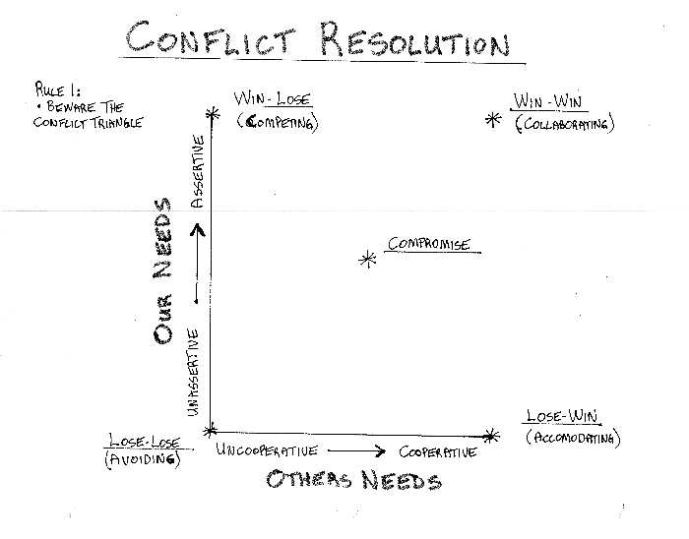
Win-Win Negotiation
Win-lose – competitive or distributive bargaining
Win-win – collaboration or integrative bargaining
Expand the value or resources available to all participants
Equitable sharing of a larger and expanded pie

Slide 48
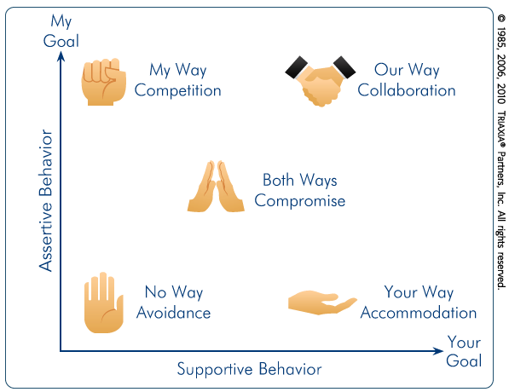
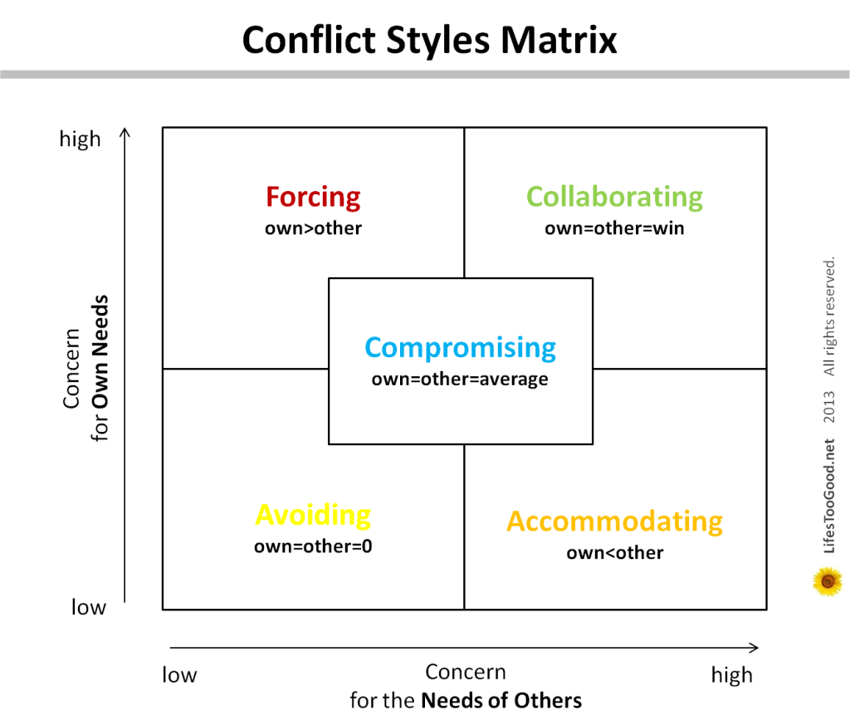
Win-Win Negotiation

Slide 49
Win-Win Methods
Expand the pie
Logroll
Use nonspecific compensation
Cut the costs for compliance
Find a bridge solution

Slide 50
International Negotiation
Added complexity and challenge
Substantial extra time and effort required
Culture shock
Barriers and obstacles
Need for translators

Slide 51
Barriers and Obstacles
Miscommunication due to language
Time limitations
Cultural differences
Limited authority of international negotiators
Characteristics to Overcome Barriers
Patience
Knowledge of the contract agreement
Honest and polite attitude
Familiarity with foreign cultures and customs

Slide 52
Caveats when Negotiating Overseas
Don’t think that everyone else negotiates like the Americans
There is a danger in stereotyping or oversimplifying characteristics of other cultures
There is always substantial interpersonal variation within any culture
However, there are often common tendencies

Slide 53
Impact of the Internet on Negotiations
Electronically-based negotiations tend to equalize the differences between the parties
Normal visual and auditory clues are diminished or not readily apparent
Status differences and social differences are less discernible
Problem of being anonymous
Negotiators tend to be more risk taking

Slide 54
Impact of the Internet on Negotiations
Real time vs. asynchronous
Loss of information richness
More difficult to provide feedback and conduct active listening
E-negotiators ask fewer questions and tend to make more assumptions

Slide 55
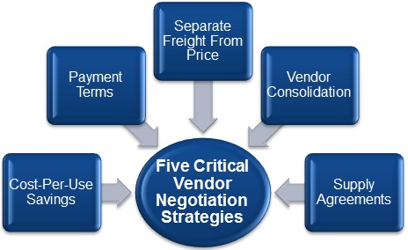
Fair and Reasonable price
Vendor Negotiation: Top 5 Negotiation Strategies That Lower Costs
http://www.driveyoursuccess.com/2010/09/vendor-negotiation-top-5-negotiation-strategies-that-lower-costs.html

Slide 56
Fair and Reasonable price
six ways to make sure your next supplier negotiation session produces favourable results:
1. Renegotiate all contracts annually
Annual bidding or at least renewal discussions with the current suppliers.
2. Conduct regular spend assessments
conduct regular spend assessments on specific vendors
3. Aggregate volume buys across the organization
aggregate volume purchases across fragmented organizations, divisions and entities e.g. Various plants of Toyota asking the same vendor for aggregate order
gaining economies of scale and better negotiating power
4. Help suppliers work more efficiently
Suggesting options or vendor development e.g. suggesting another material option to vendor when material costs around 80% of the cost
Or doing bulk orders e.g. Maruti buys steel in bulk through which it provides steel to vendors at much lower cost
5. Explore the alternatives
Setting right Process at vendor development
6. Come at it from the win-win perspective
Notes:
http://www.digikey.com/en/articles/techzone/2013/nov/6-steps-to-more-effective-supplier-negotiations

Slide 57
On-Time Performance
Meeting delivery schedules for the specified quality and quantity.
Premium price for premium performance.
Example: Here's what we propose: you reduce your price by 10%; however, if you deliver within 30 days after receipt of our order as you promised, we'll pay the price in your proposal.

Slide 58
Control
Man hours of efforts
Level of scientific talent
Special test equipment requirements
The amount and type of work to be subcontracted
Progress report
Notes:
Consider an example of Raipur Metro Plan

Slide 59
Cooperation
Rewarding performing suppliers with future orders
Pleasant working relations
Timely payments
Cooperation from their customers
Cooperation begets cooperation

